Slide 1
VIP 2.0
Team Members:
Tiago Moore, Victoriano Vega, Steven Rowe,
Jorge Perez, Andres Villa, Miguel Conde, Rodolfo Viant Product Owner:
Masoud Sadjadi Instructor:
Masoud Sadjadi
School of Computing and Information Sciences Florida International University
Senior Project Final Presentation Spring 2016
4/25/2016
Notes:
Greet your audience, thank them for attending your presentation, introduce yourself, introduce your project, introduce your team members, and quickly indicate what each of you did in a high-level manner, and put more emphasis on your part/contribution.

Slide 2
Problem Definition
Our Project
The vertically Integrated Projects (VIP) program aims to involve everyone on campus in innovation. VIP unites undergraduate education and faculty research in a team-based context. VIP students earn academic credits while faculty and graduate students benefit from the design/discovery efforts of their teams.
Current Problems
Lacked the ability to accept/reject grades
View/update user profile page
Ability for admin to filter email selections
Social media account linking
Pagination on all grids
Export grades/judges
Import Students
Manage Student/Judges information
My Part
About Page
Syllabus Page
Receive Project Proposal Notification Change Forgotten Password
Notes:
Introduce the problem that the whole project tackles and stay focused on the parts that you have been working. Indicate if there is an existing previous system, enumerate its problems/limitations, etc.
‹#›

Slide 3
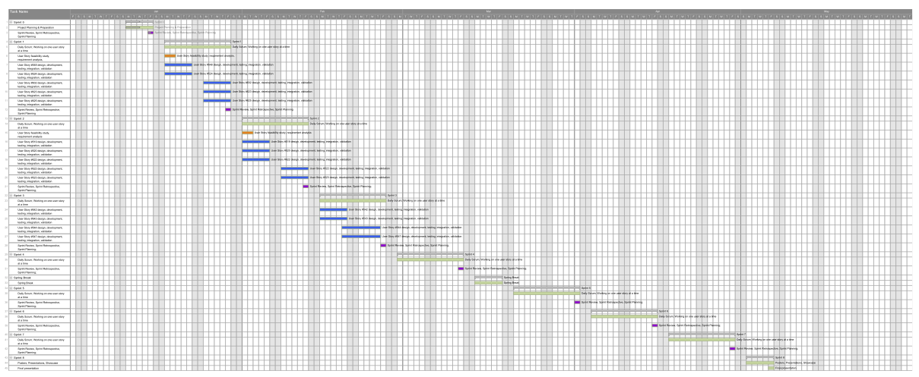
Full Gantt chart
Notes:
‹#›

Slide 4
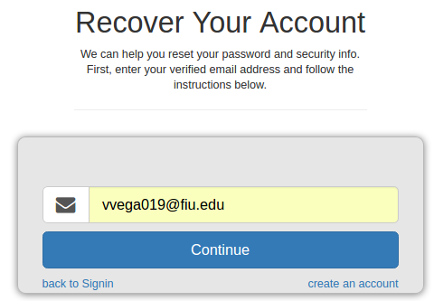
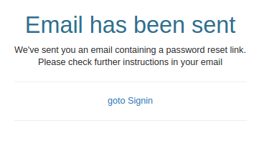
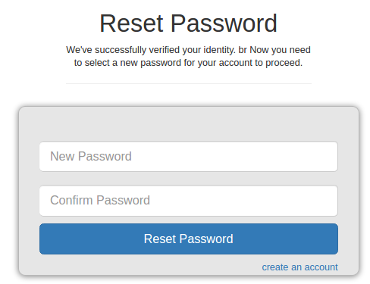
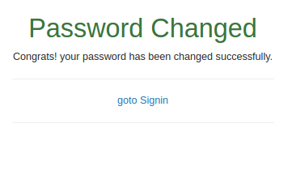
User Stories Implemented
#841 – View About VIP Page
#853 – View VIP Syllabi Information
#672 – Receive Project Proposal Notification
#927 – Change Forgotten Password
Notes:
4. Requirements:
4.1. User stories implemented (one or more slides).
4.2. UML use cases and the use case diagram for the implemented use cases (one or more slides).
4.3. UML sequence diagrams for the implemented use cases.
‹#›

Slide 5
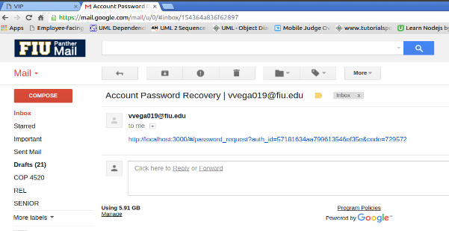
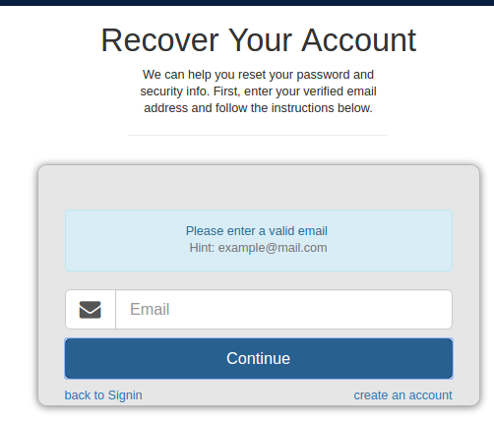
Requirements: Change Forgotten Password
Description:
As a user, I would like to be able to change my password through my registered email, so that I may be able to access my account if I forgot my current password.
Acceptance Criteria:
When the registered user forgets its password, the system will ask for a valid email address
If the user enters a valid and also registered email address, the system will send a link to that email to start the process of changing the password. This message will be shown: “Please check further instructions in your email”.
If the user enters an email address that is valid but not registered in the database, the system will say: “This email is not registered in the system”.
If the email address is invalid, the system will say: “Please enter a valid email”
Notes:
4. Requirements:
4.1. User stories implemented (one or more slides).
4.2. UML use cases and the use case diagram for the implemented use cases (one or more slides).
4.3. UML sequence diagrams for the implemented use cases.

Slide 6
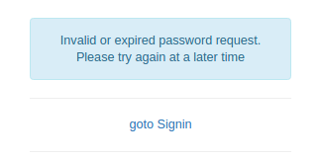
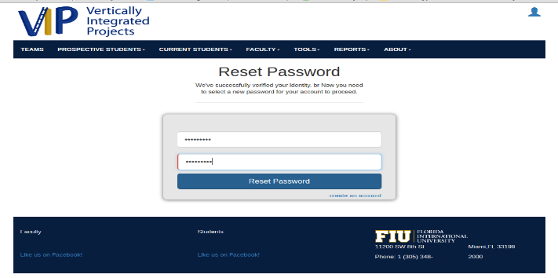
Requirements: Change Forgotten Password
Acceptance Criteria:
The link sent to the email to start the process of changing the password will be valid for one hour if it was not touched.
If the user changes its password successfully, the link will not be valid anymore.
The password will have the same constraints as the ones in the “Register User” #717 user story
Only strong passwords are allowed
Password should have at least 8 characters.
Password should have at least one upper case letter (A – Z)
Password should have at least one lower case letter (a-z)
Password should have at least one digit (0 – 9)
Password should have at least one special Characters of !@#$%&*()
Notes:
4. Requirements:
4.1. User stories implemented (one or more slides).
4.2. UML use cases and the use case diagram for the implemented use cases (one or more slides).
4.3. UML sequence diagrams for the implemented use cases.

Slide 7
Requirements: Use Cases
Notes:
4. Requirements:
4.1. User stories implemented (one or more slides).
4.2. UML use cases and the use case diagram for the implemented use cases (one or more slides).
4.3. UML sequence diagrams for the implemented use cases.
‹#›

Slide 8
Requirements: Use Cases #927 – Change Forgotten Password
Details:
Actor: User
Pre-conditions:
User have successfully navigated to http://vip-dev.cis.fiu.edu/#/
User clicks on the blue icon in order to login.
Description:
Use case begins when user clicks on “Forgotten your Password?” link, which is located in the bottom left part of the login window form.
Clicking on that link will redirect you to another page in order to reset your password.
The user will enter the registered email in order to receive the instructions to reset his/her password.
When the user clicks on the “Continue” button, the email will be sent to start the process of changing the password.
The user opens the email and clicks on the link that was sent.
Notes:
4. Requirements:
4.1. User stories implemented (one or more slides).
4.2. UML use cases and the use case diagram for the implemented use cases (one or more slides).
4.3. UML sequence diagrams for the implemented use cases.
‹#›

Slide 9
Requirements: Use Cases #927 – Change Forgotten Password
Details:
Actor: User
Description:
When the user clicks on the link, it will be redirect to the VIP page again in order to change the password.
User enters new password and retype again the new password to confirm that those match perfectly.
The new password will be stored in the mongo database.
Post-conditions:
The password will be updated with the new information.
Alternate Course of Action:
In step D.3, the user has to enter a valid and registered email.
In step D.6, the user has to enter a strong password and also meet the requirements of entering the new password.
Notes:
4. Requirements:
4.1. User stories implemented (one or more slides).
4.2. UML use cases and the use case diagram for the implemented use cases (one or more slides).
4.3. UML sequence diagrams for the implemented use cases.
‹#›

Slide 10
Requirements: Use Cases #927 – Change Forgotten Password
Constraints:
Usability:
No training time required.
The user should be able to use this case easily.
Reliability:
Mean time to failure – 5% failures for every twenty four hours of operation is acceptable.
Availability: Down time for login back-up 30 minutes in a 24 hour period.
Performance:
Request for change the password should be done immediately after being requested.
The system should be able to handle as many forgotten password requests as the user needs.
Supportability:
The link for reset password will be correctly displayed in Chrome, IE, and Firefox.
Notes:
4. Requirements:
4.1. User stories implemented (one or more slides).
4.2. UML use cases and the use case diagram for the implemented use cases (one or more slides).
4.3. UML sequence diagrams for the implemented use cases.
‹#›

Slide 11
Requirements: Sequence Diagrams
Notes:
4. Requirements:
4.1. User stories implemented (one or more slides).
4.2. UML use cases and the use case diagram for the implemented use cases (one or more slides).
4.3. UML sequence diagrams for the implemented use cases.
‹#›

Slide 12
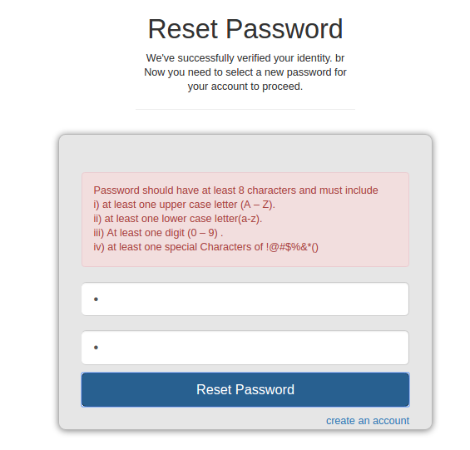
Algorithm: Admin Searches for Judge/Student
function challengePasswordStregnth(pwd) {
console.log(pwd)
var array = [];
array[0] = /[A-Z]/g.test(pwd);
array[1] = /[a-z]/g.test(pwd);
array[2] = /\d/g.test(pwd);
array[3] = hasSpecialChars(pwd)
var sum = 0;
for (var i= 0; i < array.length; i++) {
sum += array[i] ? 1 : 0;
}
console.log("sum", sum)
return pwd.length >= 8 && sum == 4
function hasSpecialChars (string) {
return string.indexOf('!') != -1 ||
string.indexOf('@') != -1 ||
string.indexOf('#') != -1 ||
string.indexOf('$') != -1 ||
string.indexOf('%') != -1 ||
string.indexOf('&') != -1 ||
string.indexOf('*') != -1 ||
string.indexOf('(') != -1 ||
string.indexOf(')') != -1
}
}
Notes:
4. Requirements:
4.1. User stories implemented (one or more slides).
4.2. UML use cases and the use case diagram for the implemented use cases (one or more slides).
4.3. UML sequence diagrams for the implemented use cases.

Slide 13
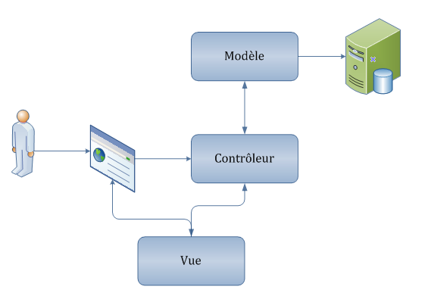
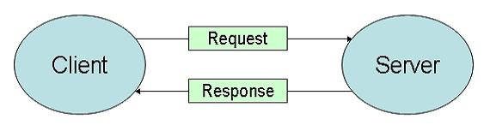
System Design: Architecture
MVC
Client-Server
Notes:
5. System design:
5.1. System decomposition; identify the architecture patterns used (one slide).
5.2. System deployment – h/w and s/w requirements (one slide).
5.3. Persistent data design (one slide).
5.4. Security/Privacy (one slide).
‹#›

Slide 14
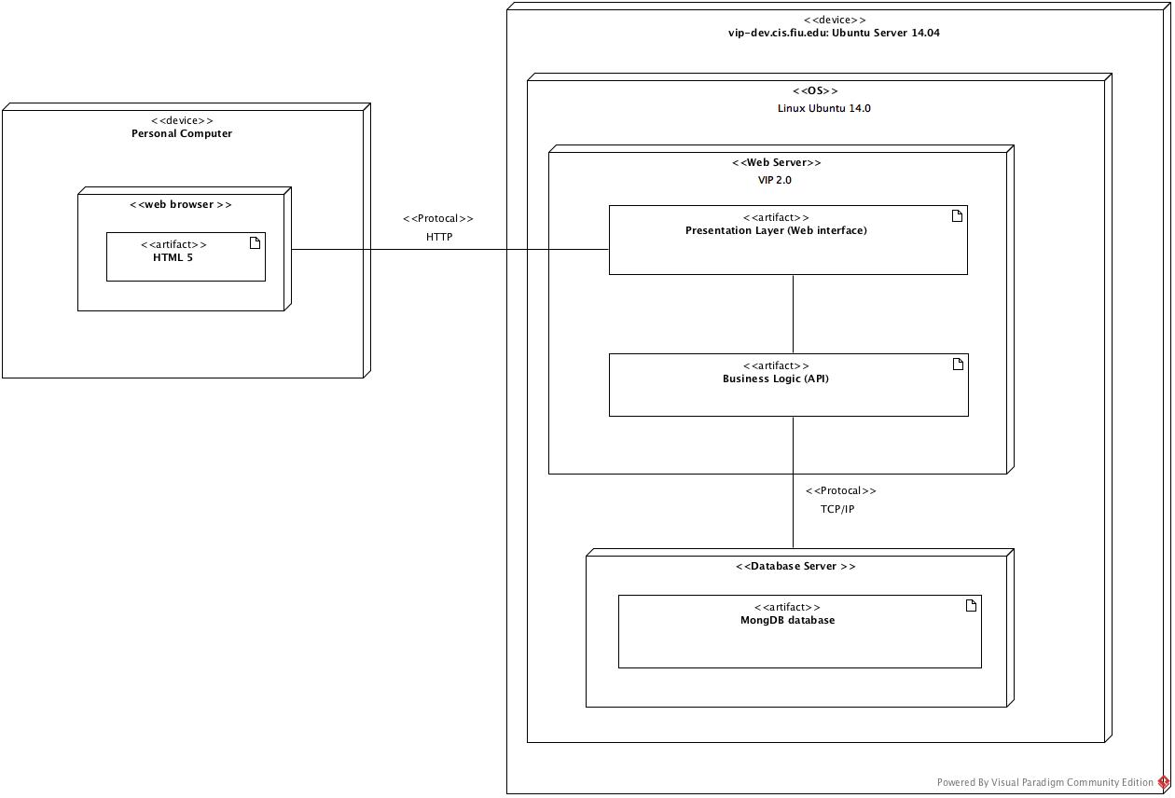
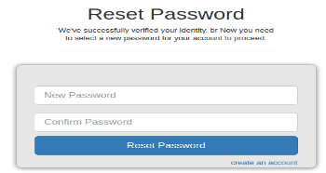
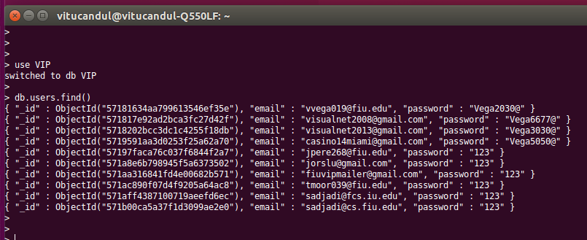
System Design: Deployment
Notes:
5. System design:
5.1. System decomposition; identify the architecture patterns used (one slide).
5.2. System deployment – h/w and s/w requirements (one slide).
5.3. Persistent data design (one slide).
5.4. Security/Privacy (one slide).
‹#›

Slide 15
Test Cases -#927 Change Forgotten Password
Sunny Day
Purpose
To test if the system will accept the new password entries and constraints.
Precondition
User is logged into the system
User opens email and clicks on the link sent
User has successfully redirected to the new password form
Input
User enters new password
User confirms the new password
User clicks on “Reset Password” button
Expected Result
A message saying “Password Changed” will be displayed.
Actual Result
A message saying “Password Changed” will be displayed.
Notes:
7. Test Suites and Test Cases (one sunny day and one rainy day) for the use case represented in part (5) above (2 slides).
7.1 One sunny day and one rainy day for the implemented use cases (one or more slides).
7.2 Automated test scripts for the implemented use cases (one or more slides).
‹#›

Slide 16
Test Cases -#927 Change Forgotten Password
Rainy Day
Purpose
To test if the user can reset his/her password and update the information in the mongo database.
Precondition
User is logged into the system
User opens email and clicks on the link sent
User has successfully click be redirected to the new password form
Input
User enters new password
User confirms the new password
User clicks on “Reset Password” button
Expected Result
A message saying “Password Changed” will be displayed.
Actual Result
Error message pops up with message “You have lost connection” because the server is down.
Notes:
7. Test Suites and Test Cases (one sunny day and one rainy day) for the use case represented in part (5) above (2 slides).
7.1 One sunny day and one rainy day for the implemented use cases (one or more slides).
7.2 Automated test scripts for the implemented use cases (one or more slides).
‹#›

Slide 17
Thank you!
Contact information:
Victoriano Vega email: vvega019@fiu.edu
Notes:
Summarize your contribution
Include your contact information
Ask if anyone has any questions for you.
Thank your audience
‹#›

